Slide 1
ECON4330 Final Project Presentation: Breast Cancer
By: Jerry Fang, Changhong Liang, and Marcus Murphy

Slide 2
Introduction and Question
We decided to explore breast cancer prediction and diagnosis given that October is Breast Cancer Awareness Month
We would like to know
What ML methods we can use to predict and diagnose breast cancer?
Which methods are the most effective in correctly diagnosing?
What factors do the most contribution to be assigned with a cancer for people?
What should we do to prevent the breast cancer?

Slide 3
Background
Breast cancer has overtaken lung cancer as the most commonly diagnosed cancer in women worldwide
Data mining algorithms applied in healthcare industries play a significant role due to their high performance in:
Predicting
Diagnosis of the diseases
Reducing costs of medicine
Making real time decisions to save people’s lives
Most common data mining modeling goals are classification and prediction

Slide 4
Literature Review
The article “Machine Learning Algorithms For Breast Cancer Prediction And Diagnosis” (Naji, Filali, et al.) has gauged our interest in this study, based on a study which predicts and diagnoses breast cancer using ML methods
It explores the models that can precisely predict the status (belign/malignant) of breast cancer among 10 covariates.
Methods used in this study
Support Vector Machine (SVM) (a supervised model that uses classification and regression analysis)
Random Forest
Logistic Regression
Decision Tree (C4.5)
K-Nearest Neighbors (KNN)
We used boosting and classification in addition to most of the processes outlined in the paper.

Slide 5
Dataset
Breast cancer data scraped from “Breast Cancer Wisconsin (Diagnostic) Data Set.
Raw data focuses on fine-needle aspirate images of cell nuclei and features
radius (mean of distances from center of nucleus to perimeter)
Texture (standard deviation of gray-scale values of the image)
Compactness (Perimeter^2/(Area-1))
Concavity (severity of concave portions of the contour)
Concave points (number of concave points on the contour)
Symmetry
Fractal dimension (“Coastline Approximation”-1)

Slide 6
Methodology
We have used the following methods for the project:
Decision Trees
Classification Trees
Classification Forest
Logistics Regression (multi)
Boosting

Slide 7
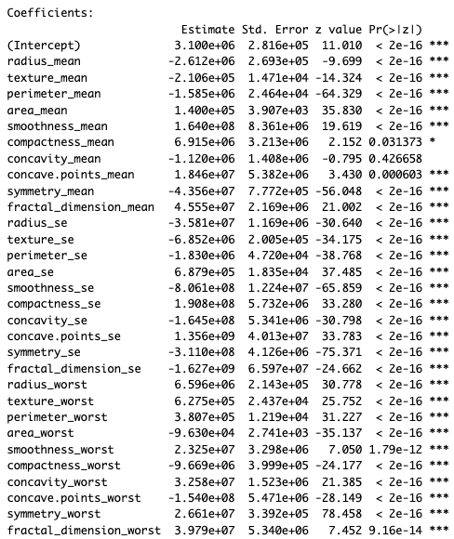

Results
Classification Tree: Misclassification error rate: .01757=10/569
Classification Forest Error Rates:
Logistic Regression (diagnosis=1, benign tumor, =0, malignant tumor) →

Slide 8
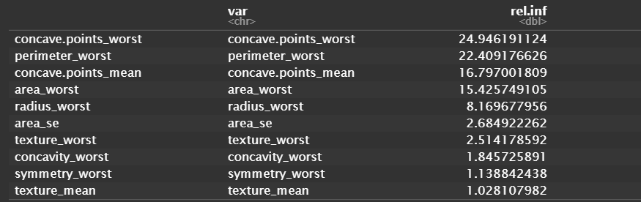
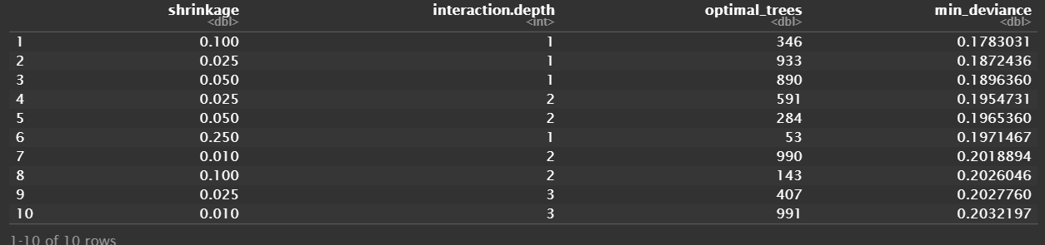
Results (Continued)
Boosting:
Much of the study focuses on the data behind lumps/lesions/tumors, or other samples of breast cancer. It is data collected from those who have gotten fine needle aspirations done, leading us to believe they already had suspicion of having breast cancer. The coefficients on the covariates seem to imply that as many of these cell nuclei become larger, more dense, the more serious the diagnosis. Hence, there is an importance for regular checking for suspicious lumps.

Slide 9
References
https://www.sciencedirect.com/science/article/pii/S1877050921014629
https://www.cdc.gov/cancer/breast/basic_info/diagnosis.htm
https://www.cancer.org/cancer/breast-cancer/about/how-common-is-breast-cancer.html#:~:text=Trends%20in%20breast%20cancer%20deaths&text=Breast%20cancer%20death%20rates%20have,as%20well%20as%20better%20treatments.

